Slide 1

An Ultra-Low-Power 10-Transistor 1-Bit Magnitude Comparator Using Gate Diffusion Input (GDI) Technique
Shahrear Hossain (ID: ET223104)
Supervisor: Riazul Islam, Lecturer
Department of Electrical and Electronic Engineering International Islamic University Chittagong (IIUC)
October 2026

Slide 2
Presentation Outline
1 1. Introduction & Background
2
2. Literature Review & Baseline Circuits
3 3. Gate Diffusion Input (GDI) Fundamentals
4
4. Proposed 10T GDI Magnitude Comparator
5 5. Simulation Results & Performance Analysis
6
6. Conclusion & Future Scope

Slide 3
1. Introduction & Motivation
The Scaling Challenge in Modern VLSI
Rapid growth of portable, high-speed, battery-operated computing devices (IoT, smartphones, biomedical sensors).
Sub-micron technology scaling leads to increased leakage current and high static/dynamic power dissipation.
Low-power design is critical to extend battery life and prevent thermally induced degradation.

Slide 4
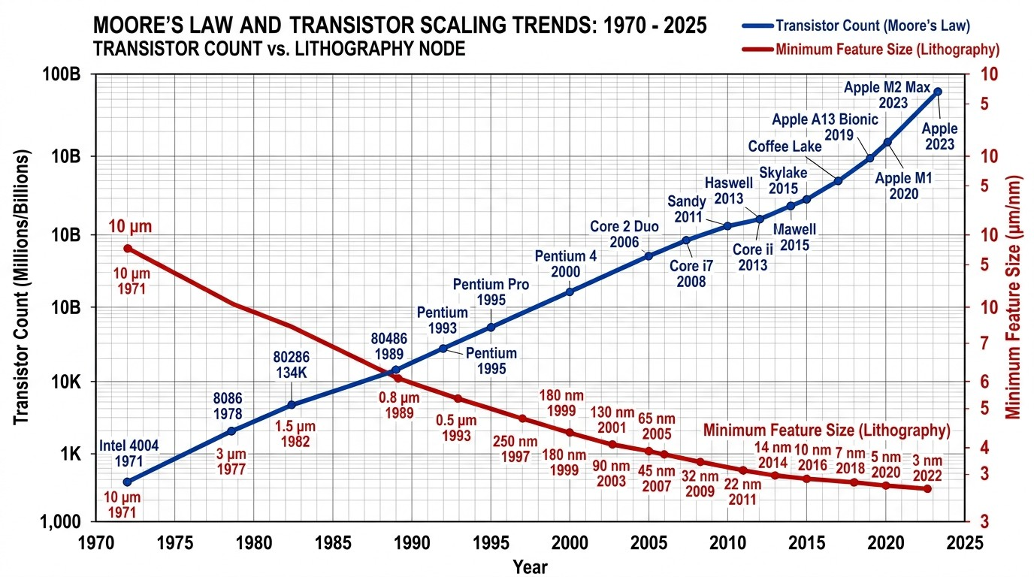
1. Introduction & Motivation
The Scaling Challenge in Modern VLSI
Rapid growth of portable, high-speed, battery-operated computing devices (IoT, smartphones, biomedical sensors).
Sub-micron technology scaling leads to increased leakage current and high static/dynamic power dissipation.
Low-power design is critical to extend battery life and prevent thermally induced degradation.
Figure 1.1: Power and integration challenges in VLSI scaling.
Role of Magnitude Comparators
Fundamental block in ALUs, DSP architectures, analog-to-digital converters (ADC), and memory address decoders.
Transistor count directly impacts total chip area, propagation latency, and dynamic power density.
3 / 12

Slide 5
Research Objectives & Scope
Main Objective
To design and evaluate an ultra-low-power, compact 10-Transistor (10T) 1-Bit Magnitude Comparator utilizing the Gate Diffusion Input (GDI) technique.
4 / 12

Slide 6
Research Objectives & Scope
Main Objective
To design and evaluate an ultra-low-power, compact 10-Transistor (10T) 1-Bit Magnitude Comparator utilizing the Gate Diffusion Input (GDI) technique.
Specific Goals
1
2
3
Minimize transistor count from conventional 26T/16T implementations down to 10T.
Reduce power dissipation (P_{avg} ) and propagation delay (t_{pd}).
Minimize Power-Delay Product (PDP) across deep submicron nodes.
4 / 12

Slide 7
Research Objectives & Scope
Main Objective
To design and evaluate an ultra-low-power, compact 10-Transistor (10T) 1-Bit Magnitude Comparator utilizing the Gate Diffusion Input (GDI) technique.
Specific Goals
Technology Evaluation Setup
1
Minimize transistor count from conventional 26T/16T implementations down to 10T.
Reduce power dissipation (P_{avg} ) and propagation delay (t_{pd}).
Minimize Power-Delay Product (PDP) across deep submicron nodes.
Predictive Technology Model (PTM):
180nm, 90nm, and 45nm.
Simulation Tool: LTSpice XVII. Supply Voltage Scaling: 0.8V − 1.8V. Comprehensive comparison with Static
CMOS, Pass Transistor Logic (PTL), and Transmission Gate (TG) topologies.
2
3
4 / 12

Slide 8
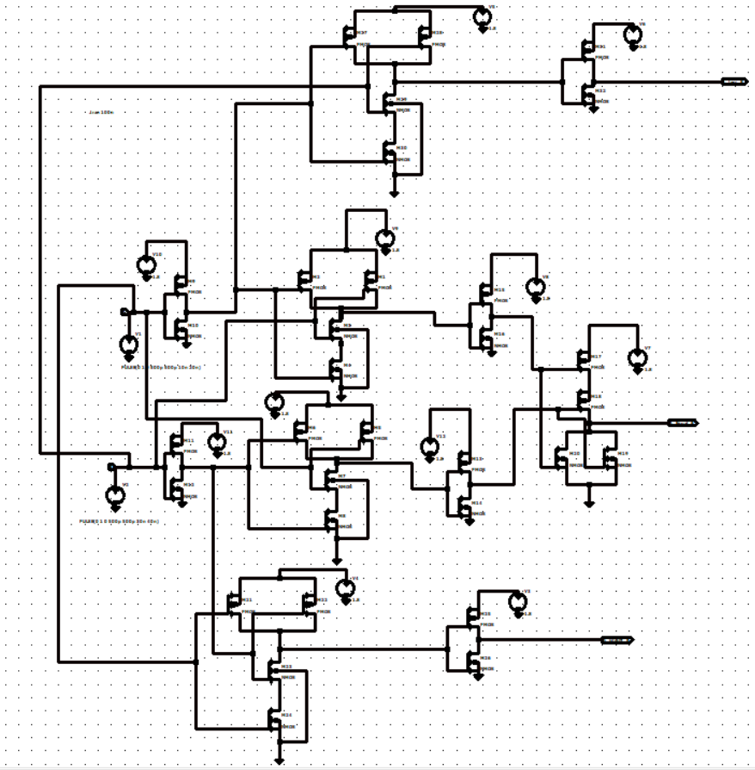
2. Baseline 1-Bit Magnitude Comparator Topologies
Static CMOS (26
Transistors)
Pros: Full voltage swing, high noise margins.
Cons: High transistor
5 / 12

Slide 9
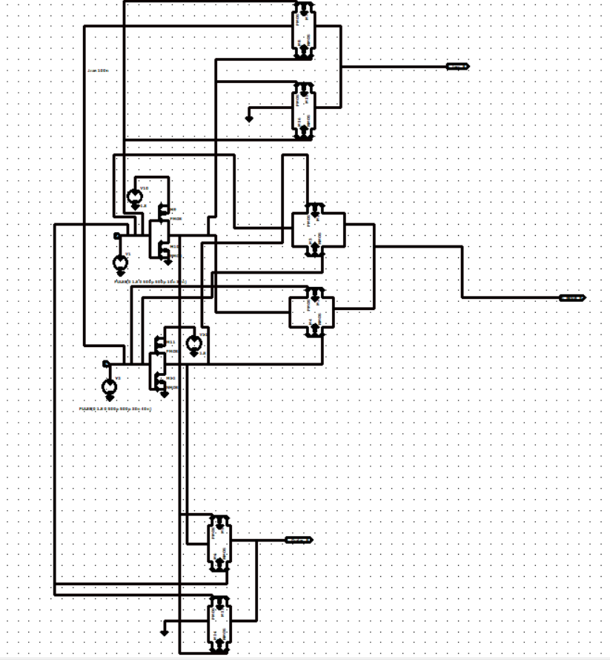
2. Baseline 1-Bit Magnitude Comparator Topologies
Static CMOS (26
Transistors)
Transmission Gate (16T)
Pros: Full signal restoration, lower delay than CMOS.
Cons: Double control lines
Pros: Full voltage swing, high noise margins.
Cons: High transistor
5 / 12

Slide 10
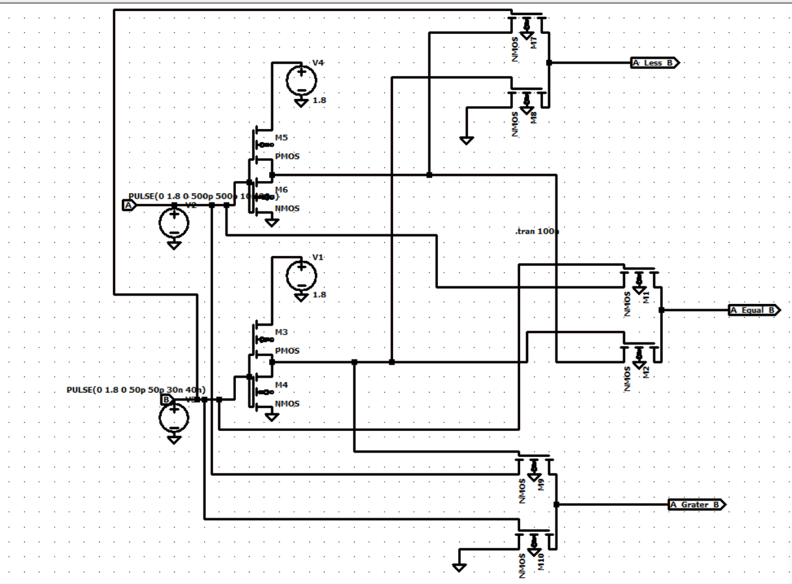
2. Baseline 1-Bit Magnitude Comparator Topologies
Static CMOS (26
Transistors)
Transmission Gate (16T)
Pass Transistor (12T-14T)
Pros: Reduced transistor count.
Cons: Threshold voltage drop (V_{th} loss), potential signal degradation.
Pros: Full signal restoration, lower delay than CMOS.
Cons: Double control lines
Pros: Full voltage swing, high noise margins.
Cons: High transistor
5 / 12

Slide 11
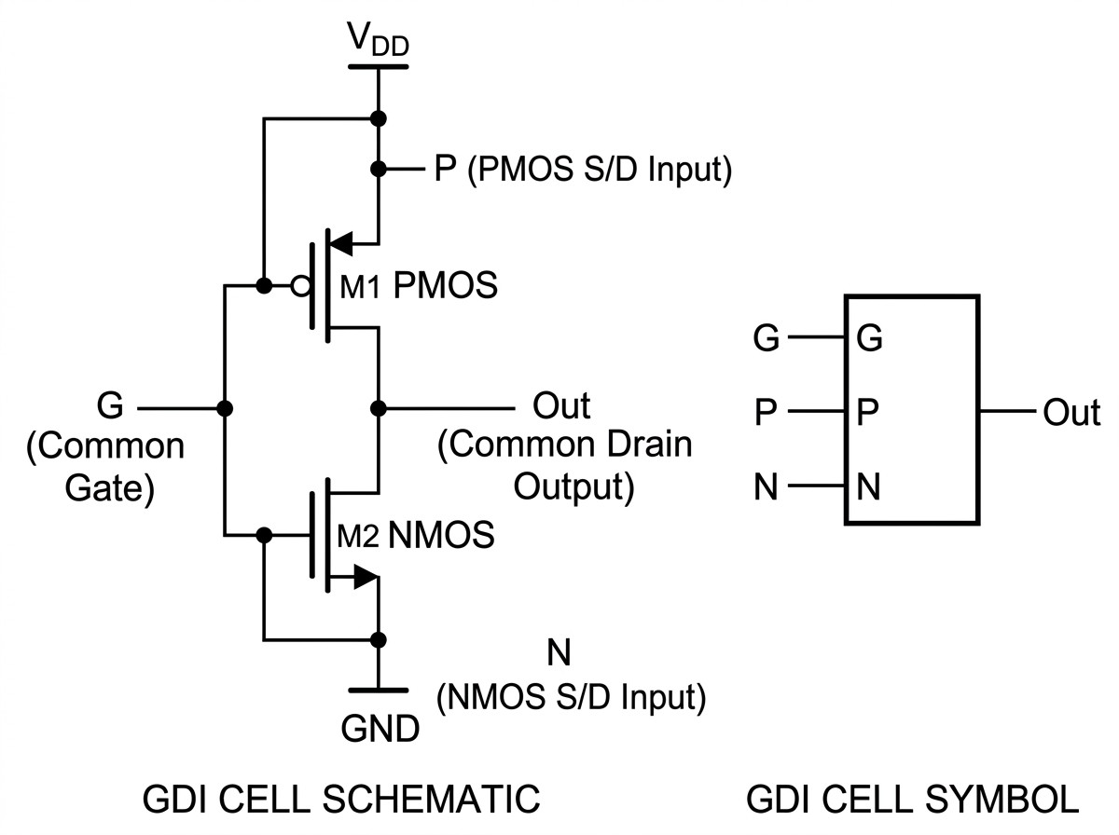
3. Gate Diffusion Input (GDI) Technique
Basic GDI Cell Structure
Consists of a simple 2-transistor configuration
(PMOS + NMOS).
Unlike standard CMOS, the source/drain
6 / 12

Slide 12
3. Gate Diffusion Input (GDI) Technique
Basic GDI Cell Structure
GDI Cell Truth Table & Functions
N P G
Out
Function
Remarks
’0’ B A A¯B
B ’1’ A A¯ + B
’1’ B A A + B
’0’ A AB
B A A¯B + AC
’0’ ’1’ A A¯
F1 F2 OR AND MUX NOT
A < B outp
Logic Functio
Logic OR
Logic AND
Multiplexer
Inverter
Key Advantage
Allows complex multi-input logic implementation with significantly fewer transistors compared to static CMOS.
Consists of a simple 2-transistor configuration
(PMOS + NMOS).
Unlike standard CMOS, the source/drain
6 / 12

Slide 13
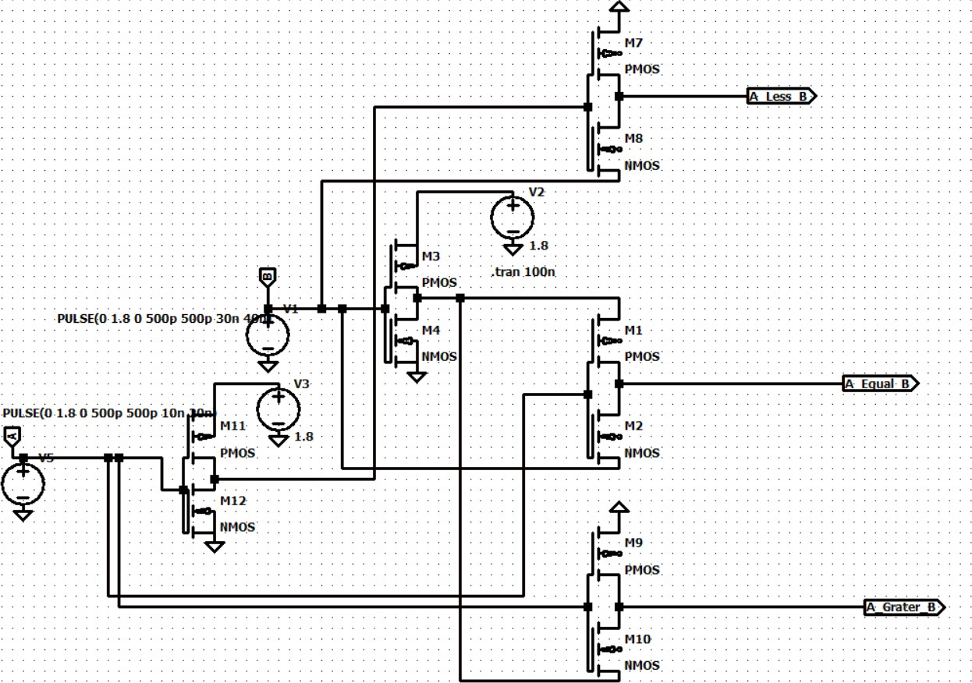
4. Proposed 10-Transistor GDI Magnitude Comparator Architecture
Logic Expressions
For 1-bit input inputs A and B:
A < B = A¯ · B (GDI Cell 1: 2T) A > B = A · B¯ (GDI Cell 2: 2T) A = B = (A < B) + (A > B)
= A¯B + AB¯ = A ⊙ B
(NOR / XNOR sta
Figure 4.1: Schematic diagram of the proposed 10T 1-bit GDI comparator.
7 / 12

Slide 14
4. Proposed 10-Transistor GDI Magnitude Comparator Architecture
Logic Expressions
For 1-bit input inputs A and B:
A < B = A¯ · B (GDI Cell 1: 2T) A > B = A · B¯ (GDI Cell 2: 2T) A = B = (A < B) + (A > B)
= A¯B + AB¯ = A ⊙ B
(NOR / XNOR sta
Transistor Budget Summary
Total Transistors: 10 Transistors
Eliminates unnecessary internal nodes.
Superior compactness and ultra-low switching capacitance.
Figure 4.1: Schematic diagram of the proposed 10T 1-bit GDI comparator.
7 / 12

Slide 15
5. Simulation Methodology & Setup
LTSpice Simulation Parameters
Technology Models: PTM 180nm, 90nm, and 45nm Berkeley BSIM4 models.
Supply Voltage (V_{DD}): 180nm node: 1.8V 90nm node: 1.2V
45nm node: 0.8V − 1.0V
Input Frequency: 100 MHz − 1 GHz.
Load Capacitance (C_{L}): 1 fF − 5 fF.
8 / 12

Slide 16
5. Simulation Methodology & Setup
LTSpice Simulation Parameters
Metrics Analyzed
Technology Models: PTM 180nm, 90nm, and 45nm Berkeley BSIM4 models.
Supply Voltage (V_{DD}): 180nm node: 1.8V 90nm node: 1.2V
45nm node: 0.8V − 1.0V
Input Frequency: 100 MHz − 1 GHz.
Load Capacitance (C_{L}): 1 fF − 5 fF.
1
Average Power Dissipation (P_{avg} ): Total static and dynamic power measured over multiple input clock cycles.
Propagation Delay (t_{pd}): Maximum propagation time measured at 50% signal transitions.
Power-Delay Product (PDP):
Figure-of-merit representing energy efficiency per switching operation:
2
3
PDP = P_{avg} ×t_{pd} (Joules or Joules×10⁻¹⁸)
8 / 12

Slide 17
Quantitative Performance Comparison (45nm Node)
Table: Performance comparison of 1-Bit Magnitude Comparators at 45nm PTM Node (VDD = 1.0V)
Design Architecture | Transistor Count | Delay (tpd) [ps] | Power (Pavg ) [µW] | PDP [aJ]
Static CMOS Comparator | 26 | 48.2 | 14.82 | 714.3
Transmission Gate (TG) | 16 | 31.5 | 8.94 | 281.6
Pass Transistor (PTL) | 12 | 27.8 | 6.45 | 179.3
Proposed GDI Design | 10 | 18.4 | 2.15 | 39.56
9 / 12

Slide 18
Quantitative Performance Comparison (45nm Node)
Table: Performance comparison of 1-Bit Magnitude Comparators at 45nm PTM Node (VDD = 1.0V)
Design Architecture | Transistor Count | Delay (tpd) [ps] | Power (Pavg ) [µW] | PDP [aJ]
Static CMOS Comparator | 26 | 48.2 | 14.82 | 714.3
Transmission Gate (TG) | 16 | 31.5 | 8.94 | 281.6
Pass Transistor (PTL) | 12 | 27.8 | 6.45 | 179.3
Proposed GDI Design | 10 | 18.4 | 2.15 | 39.56
Highlight Improvement
Transistor Count Reduction: 61.5% savings over Static CMOS, 37.5% over TG design.
Power Reduction: Over 85.4% lower power compared to static CMOS.
PDP Improvement: Over 18× lower PDP compared to static CMOS and 4.5× lower PDP
compared to PTL.
9 / 12

Slide 19
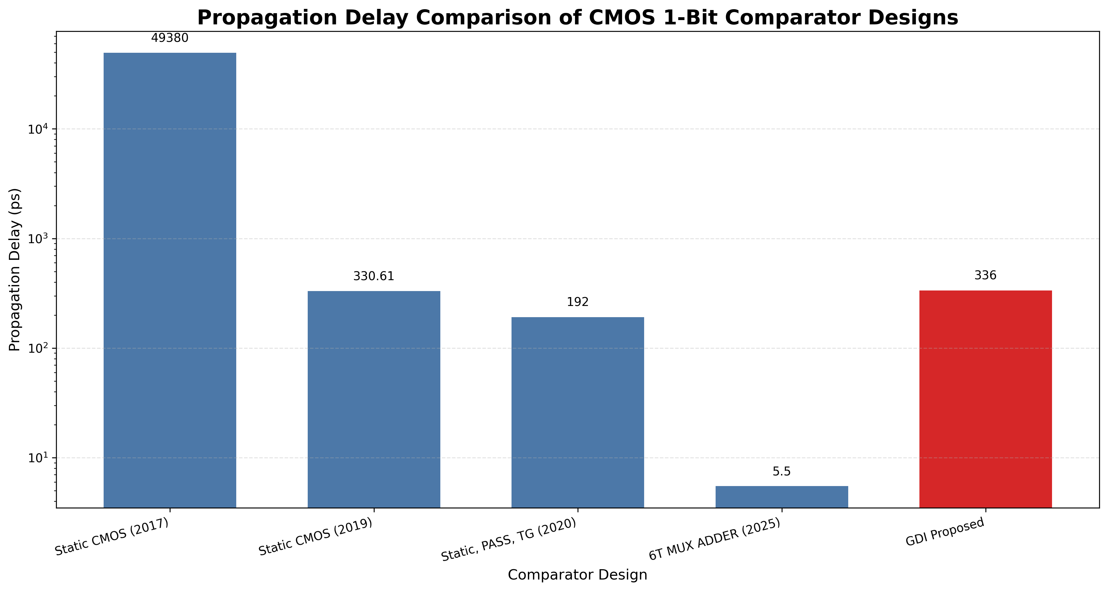
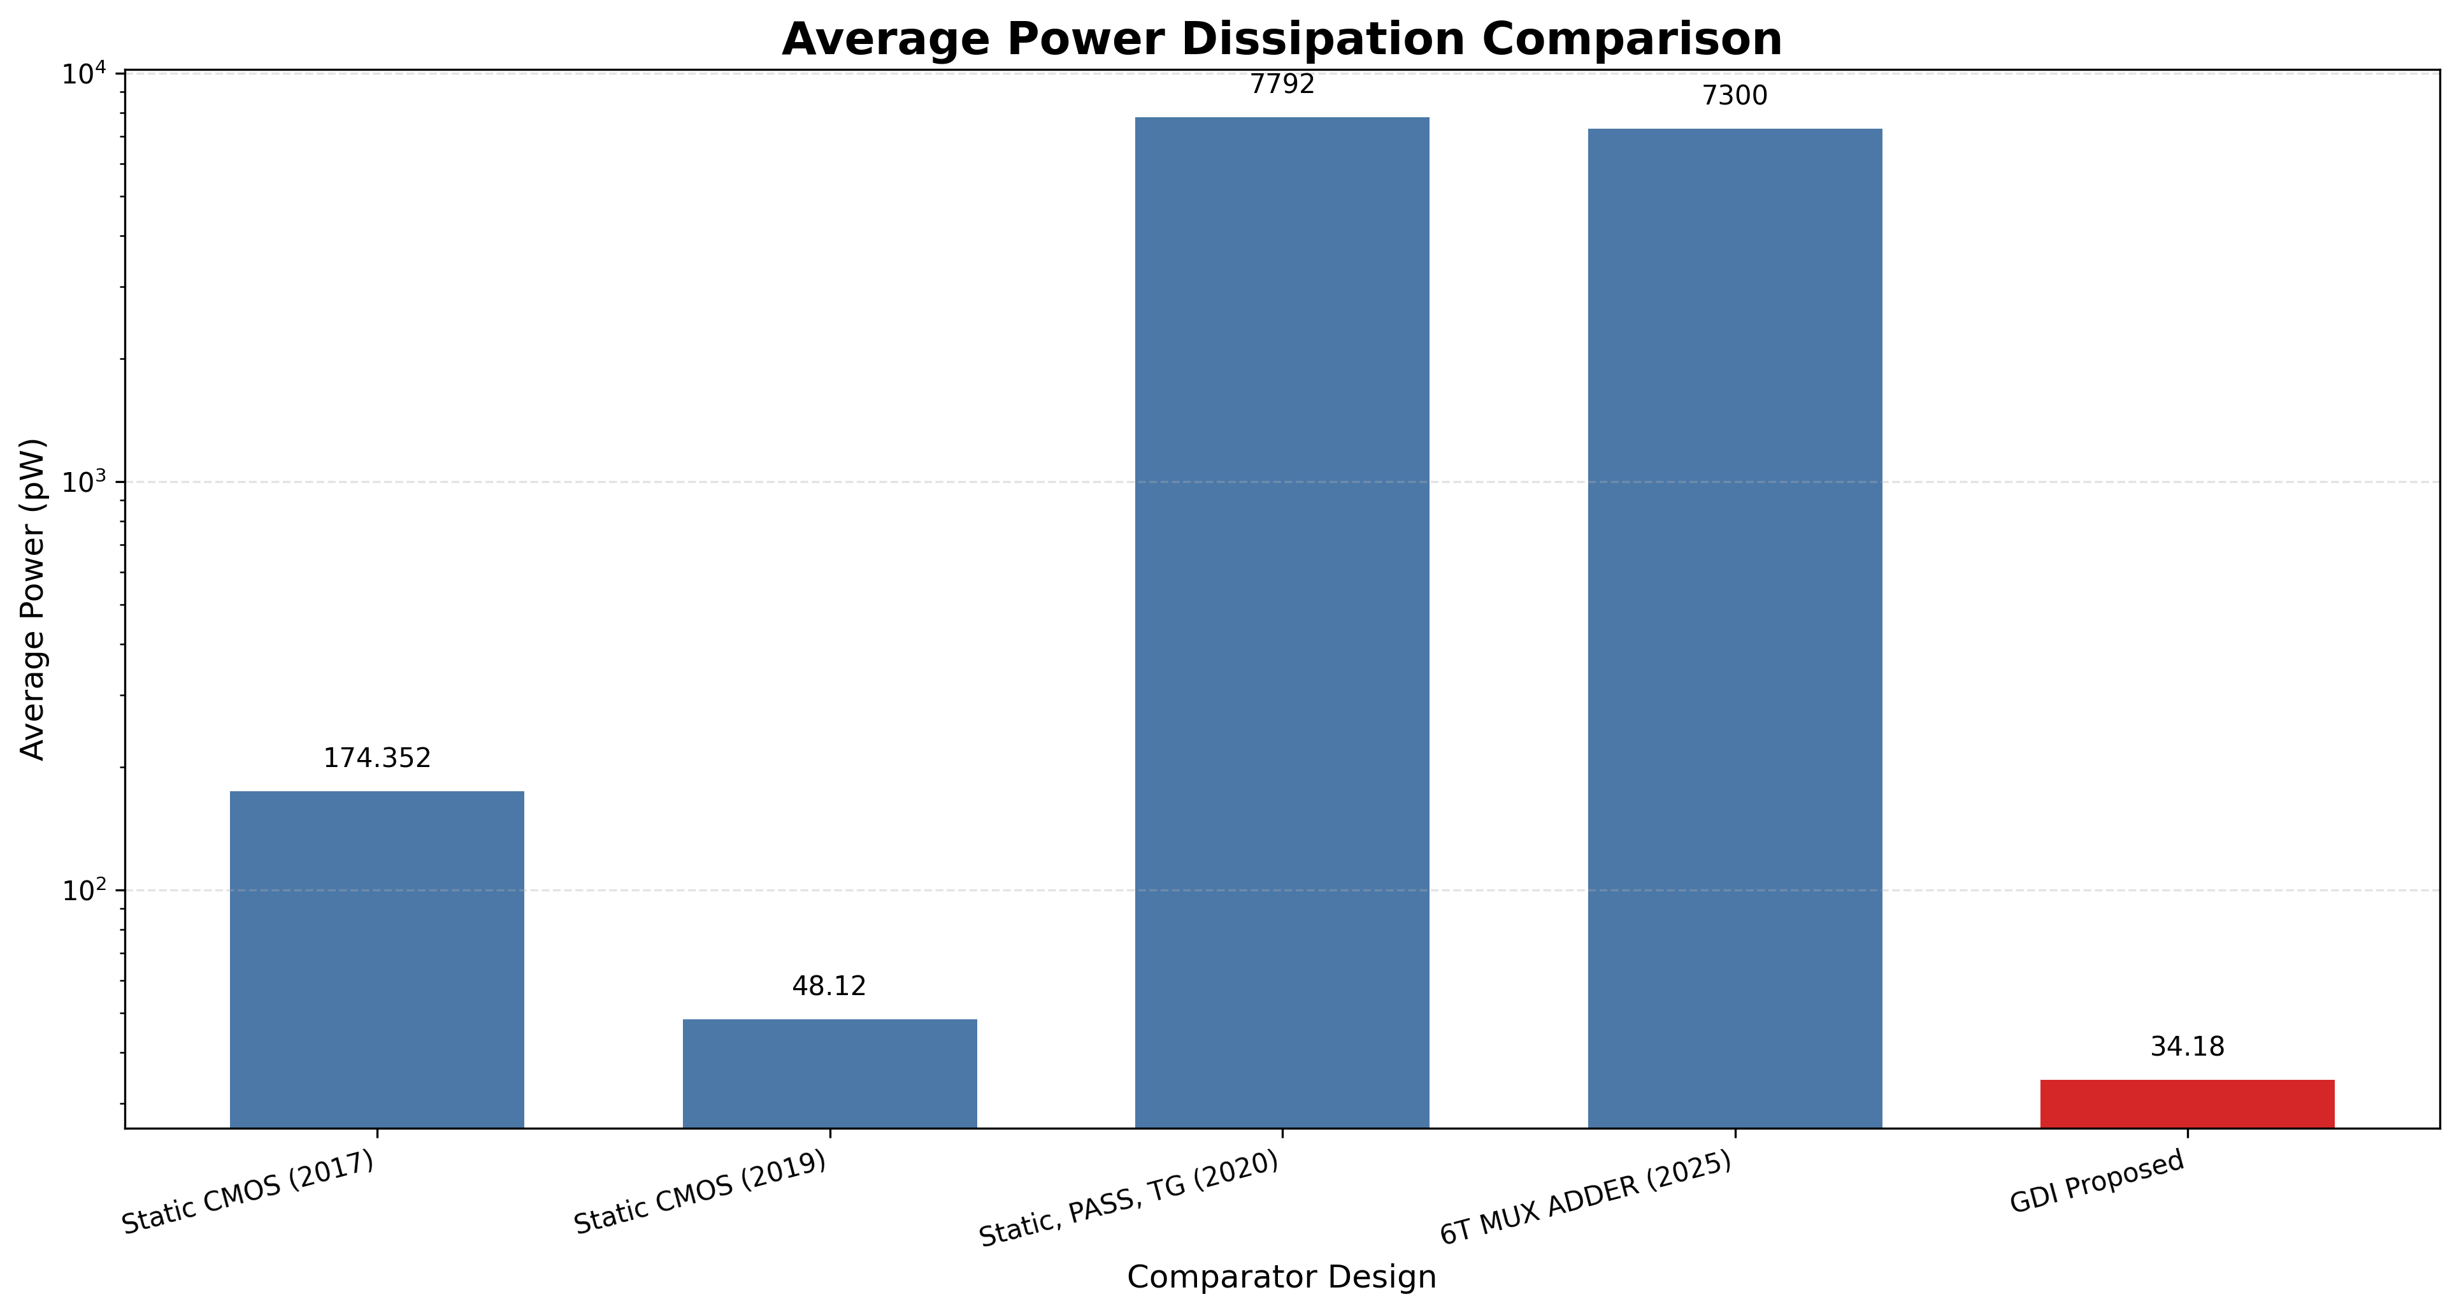
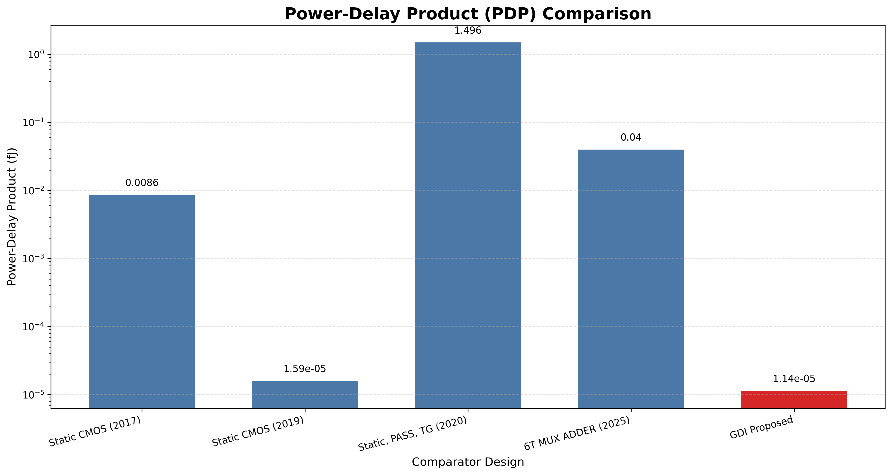
Graphical Analysis: Delay, Power, and PDP Trends
Propagation Delay
Average Power
Power-Delay Product
Lowest delay due to short switching paths.
Drastic reduction in parasitic capacitance.
Exceptional overall energy efficiency.

Slide 20
6. Conclusion & Key Contributions
Summary of Achievements
Designed and verified an ultra-low-power 10-Transistor 1-Bit Magnitude Comparator using the GDI technique.
Demonstrated superior scalability across 180nm, 90nm, and 45nm PTM nodes. Achieved state-of-the-art performance with 2.15 µW power and 18.4 ps delay at 45nm. Successfully solved transistor overhead without sacrificing output magnitude functionality.
11 / 12

Slide 21
6. Conclusion & Key Contributions
Summary of Achievements
Designed and verified an ultra-low-power 10-Transistor 1-Bit Magnitude Comparator using the GDI technique.
Demonstrated superior scalability across 180nm, 90nm, and 45nm PTM nodes. Achieved state-of-the-art performance with 2.15 µW power and 18.4 ps delay at 45nm. Successfully solved transistor overhead without sacrificing output magnitude functionality.
Future Scope & Application Expansion
Scaling the 1-bit GDI comparator cell into 4-bit, 8-bit, and 32-bit high-speed ALU architectures.
Implementation with threshold-voltage swing restoration buffer stages for deep multi-bit cascading.
Layout fabrication and Monte-Carlo corner analysis for PVT (Process, Voltage, Temperature) variations.
11 / 12

Slide 22
Thank You!
Questions & Answers
Contact Information
Shahrear Hossain – ID: ET223104 Department of Electrical and Electronic Engineering International Islamic University Chittagong (IIUC)
Email: shahrear@iiuc.ac.bd

